Slide 1
DIGITAL FORENSICS
Manahil Masroor & Komal Kaler

Slide 2
03
02
01
04
TABLE OF CONTENTS
05
DIGITAL FORENSIC PROCESS
ACPO PRINCIPLES
Identification, Evidence Collection, Analysis, Documentation, Reporting
What They Are & 4 Principles
DIGITAL FORENSICS
ANTI-FORENSICS
Definition, Uses, Types of Crimes, Example of Cases that used Digital Forensics
Encryption, Password Attacks, Steganography, Data Destruction
THE FUTURE
Cloud Forensics, SSD & NAND

Slide 3
FORENSICS SCIENCES
Scientific test or techniques involved with the detection of crime.

Slide 4
DIGITAL FORENSICS
The use of analytical and investigative techniques to identify, collect, examine and preserve evidence.

Slide 5
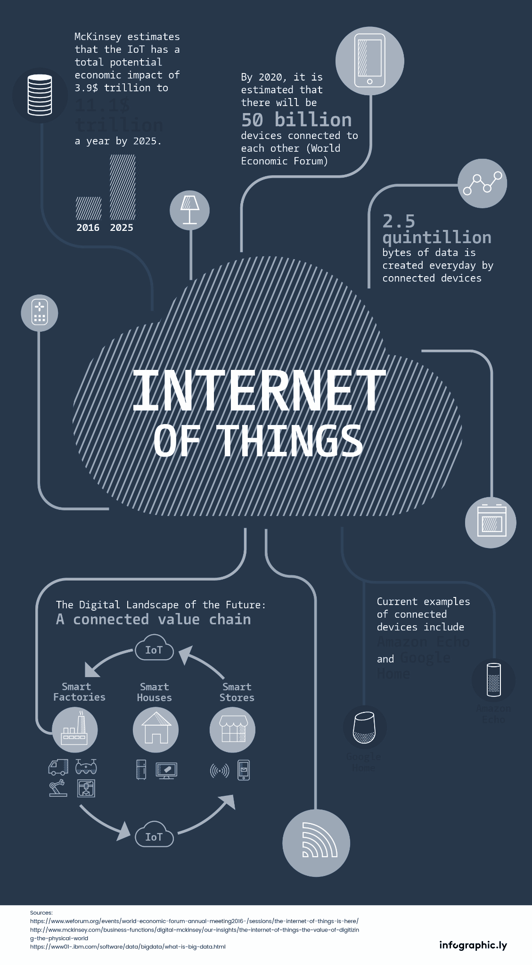
Digitalization of the World
NOT JUST COMPUTERS
ATMS
Phones
Smart Watches
pOS
Cameras
Smart Lights
Smart Washers
Smart Thermostats
Smart Locks
Smart Home Devices
Smart Cars
Anything That Can Be Connected to the Internet

Slide 6
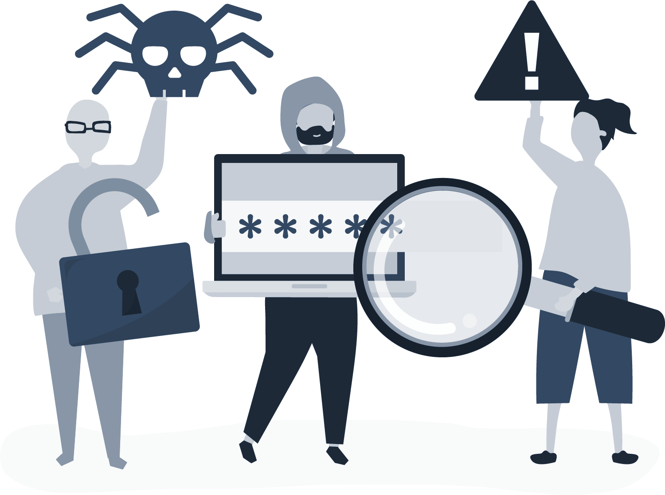
Digitized Crime
COMPUTER FACILITATED CRIME
COMPUTER BASED CRIME
Computer as a tool.
Evidence is on computer or computer was used in criminal activity.
Ex. Child Pornography, criminating emails etc.
Computer as a target.
Computer was used to target other computer or network based crime.
Ex. Ransomware, Hacking etc.

Slide 7
WHEN TO USE DIGITAL FORENSICS
Criminal Investigations
Civil Litigation
Intelligence
Administrative

Slide 8
WHEN TO USE DIGITAL FORENSICS
Our Focus
Criminal Investigations
Civil Litigation
Intelligence
Administrative

Slide 9
FAMOUS CASES

Slide 10
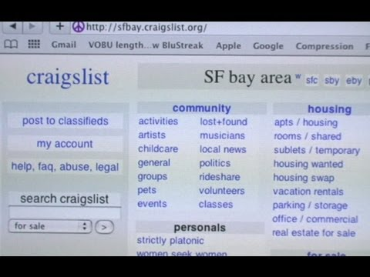
The Craigslist Killer (mobile and email)
Used Craigslist to find victims acting as a customer
FBI traced the emails exchanged between the victims to the killer and found his IP address
Subpoenaed Facebook for his account information and got trailed him to get fingerprints that would place him at the crime
Interrogation
Computer as tool crime

Slide 11
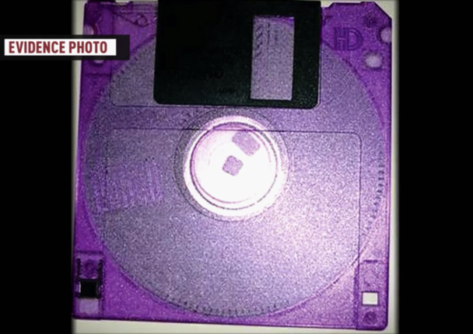
The BTK Killer (Hard Drive Metadata)
Took over 30 years to solve
From 1974 and 1991, Tortured and killed over 10 people and left notes to taunt the police
Jan 2005, Sent a floppy disk with pictures and videos of his killings and a microsoft doc
Scoured the metadata contained within the disk to find 2 things:
A church (Christ Lutheran Church)
A first name (Dennis)
Feb 2005, arrested after matching fingerprints from his car
Computer as a tool crime

Slide 12
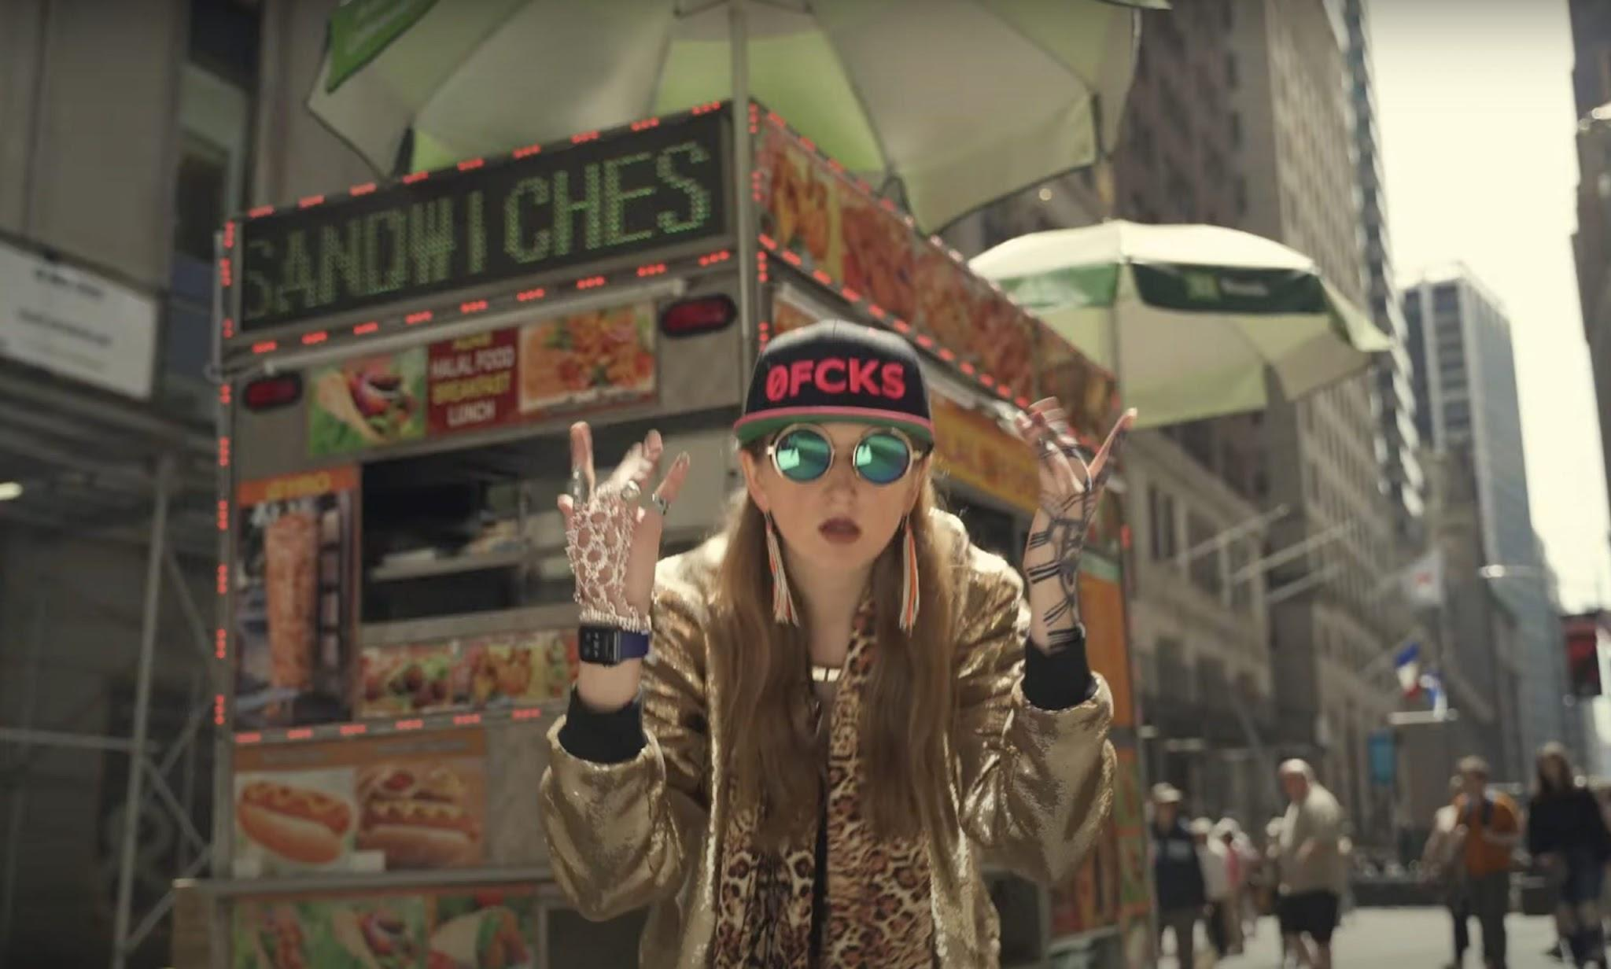
4.5 Billion BTC Heist (Email and Blockchain)
Stole 4.5 Billion from Bitfinex in 2011, was unsolved for 11 years
May 3, 2020, some of the BTC was transferred and sold in a crypto exchange that sells prepaid cards
$500 gift card for Walmart was sent to a Russian-registered email and redeemed through Walmart’s phone app.
Online orders were under Ms. Morgan’s name, using one of her emails, and the couple’s apartment address
Computer as a tool and a target crime

Slide 13
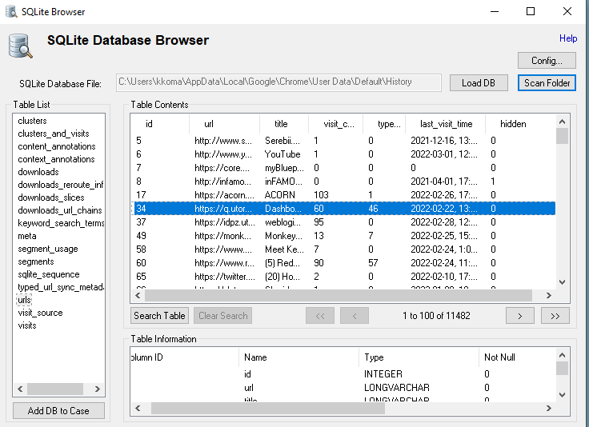
Browser Forensics (Try on Your Own Time!)
OSForensics is a popular tool used
\Users\%userprofile%\AppData\Local\Google\Chrome\User Data\Default\ (Google Chrome, Windows)
\Users\%userprofile%\Library\Safari (Safari, MacOS)
These folders contain
History
Cache
Cookies
Typed URLs
Sessions
Most visited sites
Screenshots
Financial info
Form values (Searches, Autofill)
Downloaded files (Downloads)
Favorites

Slide 14
ACPO 4 Principles
1. Evidence Tampering
3. Chain of Custody
No action taken by law enforcement agencies or agents should change data held on a computer or storage media which may subsequently be relied upon in court.
An audit trail or record of all processes applied to electronic evidence should be created and preserved. An independent 3rd party should be able to examine those processes and achieve the same result.
2. Accountability & Responsibility
4. Case Officer Responsibility
If necessary to access original data held on storage or device, person must be qualified to do so and able to give evidence explaining the relevance and implications their actions.
The person in charge of the investigation (case officer) has overall responsibility for ensuring that the law and these principles are adhered to.

Slide 15
The Digital Forensics Process
Crime Scene & First Response, Search and Seizure
Acquisition & Imaging, Live vs Dead Imaging, Hash Analysis
Timestamps, File Metadata, Windows Registry
Chain of Custody, Final Reports & Expert Witness
Identification
Evidence Collection & Preservation
Analysis
Documentation & Reporting

Slide 16
The Digital Forensics Process
Crime Scene & First Response, Search and Seizure
Acquisition & Imaging, Live vs Dead Imaging, Hash Analysis
Timestamps, File Metadata, Windows Registry
Chain of Custody, Final Reports & Expert Witness
Identification
Evidence Collection & Preservation
Analysis
Documentation & Reporting

Slide 17
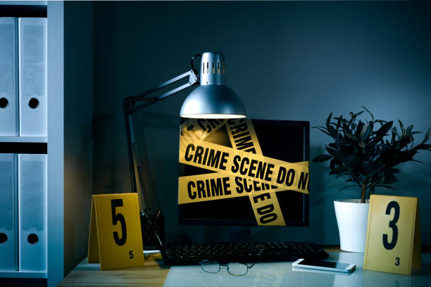
First Response & The Crime Scene
Safety
Removal of people & devices
Document (or photograph) the scene
Course of Action
Seize or Image
Disconnect from Network
Search Scene for evidence

Slide 18
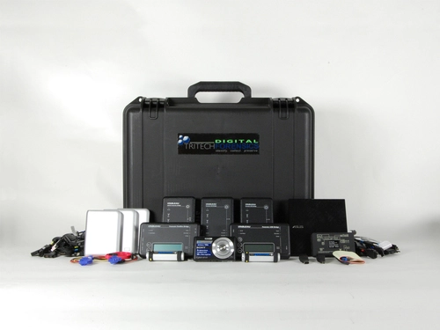
Go Kit
Labels and Stickers
Cable Ties
Anti-Static Gear
Adapters and cables (different sizes)
A write blocker
Gloves
Screwdriver
Flashlight
External Storage
Chain of custody doc
Digital camera
Recording tools (notebook, pen, digital and recorder)
Brown Paper evidence bag
Manila Folders
Evidence Tags
Scissors
Evidence/ packaging tape
Imaging Devices
Dongles
Triaging programs
Notes:
https://study.com/academy/lesson/first-responders-in-network-forensics-role-purpose.html#:~:text=A%20first%20responder%20in%20a,company%2Dissued%20desktop%20or%20laptop.

Slide 19
Search Laws in Canada
From Section 8 of the Charter of Rights:
“Everyone has the right to be secure against unreasonable search or seizure.”
1. Has there been a search and seizure?
an examination of the subject matter of the search
a determination as to whether the claimant had a direct interest in the subject matter
an inquiry into whether the claimant had a subjective expectation of privacy in the subject matter
an assessment as to whether this subjective expectation of privacy was objectively reasonable

Slide 20
Search Laws in Canada
From Section 8 of the Charter of Rights:
“Everyone has the right to be secure against unreasonable search or seizure.”
2. What does it mean to be a reasonable search?
The search is authorized by law
Warrant vs Warrantless
The law itself is reasonable
No hard test to determine
The manner in which the search is carried out is reasonable
Must identify before breaking in

Slide 21
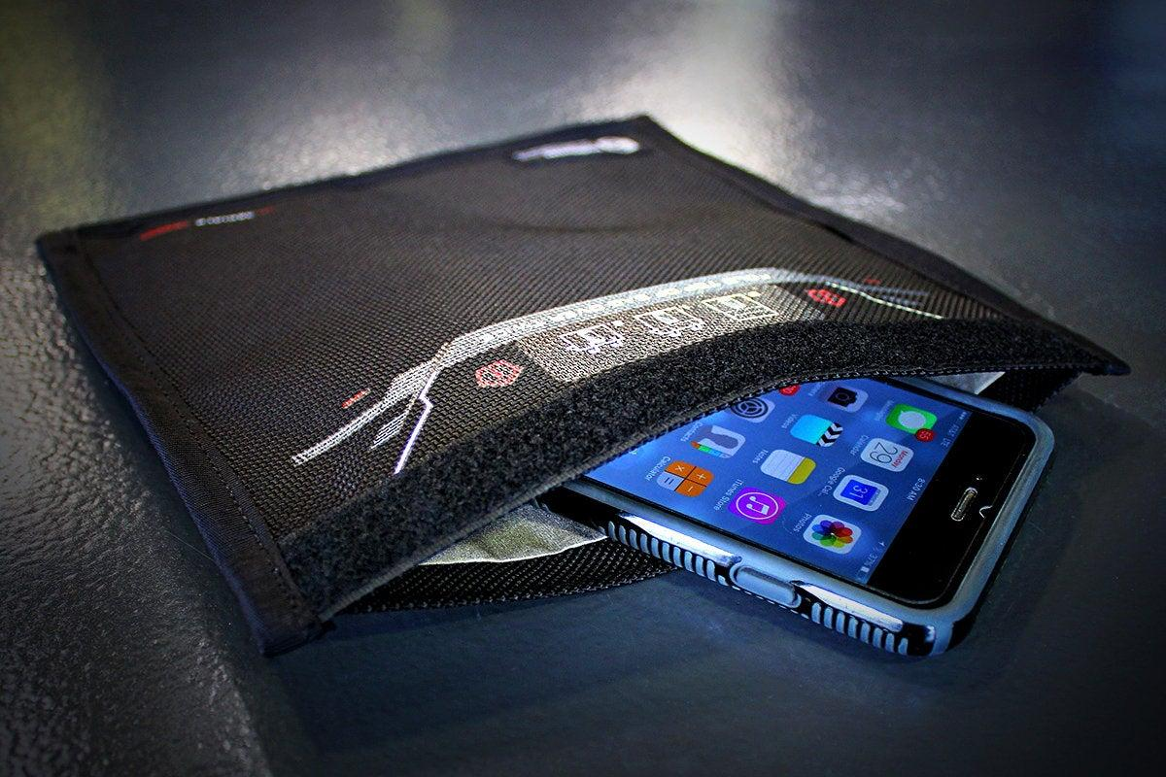
Search and Seizure
Traditional vs Digital crime scene
Don’t change the status of the device
Which status is preferred? Live or Dead
Don’t operate it
Take pictures
Faraday Bag

Slide 22
The Digital Forensics Process
Crime Scene & First Response, Search and Seizure
Acquisition & Imaging, Live vs Dead Imaging, Hash Analysis
Timestamps, File Metadata, Windows Registry
Chain of Custody, Final Reports & Expert Witness
Identification
Evidence Collection & Preservation
Analysis
Documentation & Reporting

Slide 23
ACQUISITION & PRESERVATION
Cloning
Hashing
Data is cloned and copied from original electronic source.
To verify any changes in evidence or content.
Live System vs Dead System Imaging
Powered On vs Powered Off: Which one is better?

Slide 24
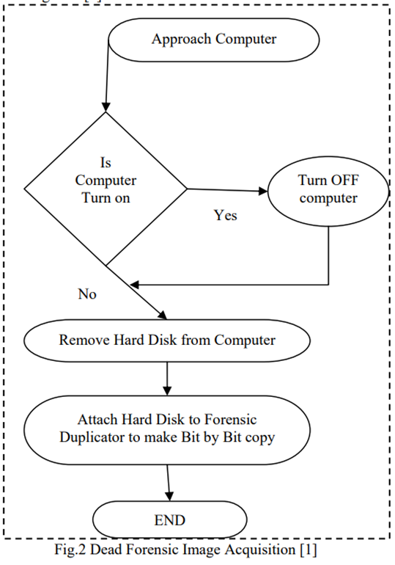
Live System vs Dead System
Imaging: Cloning/copying a physical storage for gathering evidence.
Pulling the plug was preferred but now is now subject to debate.
DEAD SYSTEMS aka Powered off Machines:
No significant or insignificant changes to system and evidence
No Legal questions to integrity
Less time than live imaging

Slide 25
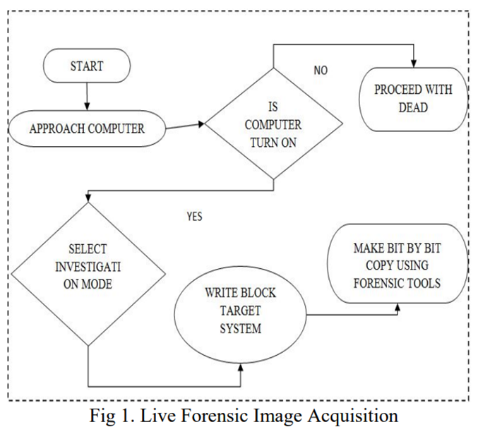
Live System vs Dead System
Imaging: Cloning/copying a physical storage for gathering evidence.
Pulling the plug was preferred but now is now subject to debate.
LIVE SYSTEMS aka Powered on/Running Machines:
Evidence and data in RAM
Unencrypted data
Live imaging of RAM

Slide 26
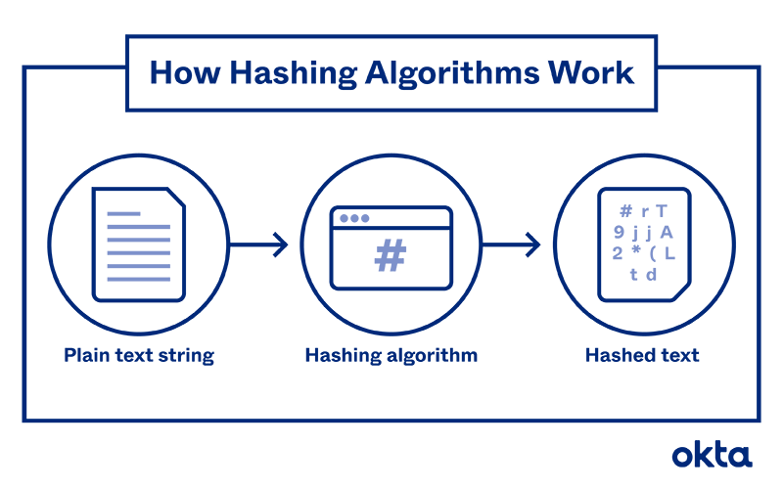
Hash Analysis
Used at any state of the digital forensics process to:
Verify clone is exact replica of original device or evidence.
Verify proper piece of evidence has been handed off.
Integrity check throughout process.
Hash Values:
Hash of original
Hash of copy

Slide 27
SHA256 c22699c05b52347fdf0046163537f3b7b8a55daad04674ad88d97aefe337cffa
SHA256 c22699c05b52347fdf0046163537f3b7b8a55daad04674ad88d97aefe337cffa
SHA256 ee03b0011a0b8b2a404329c8550b9eb90c483e64da34c7acd89ac76a0b7e6eec

Slide 28
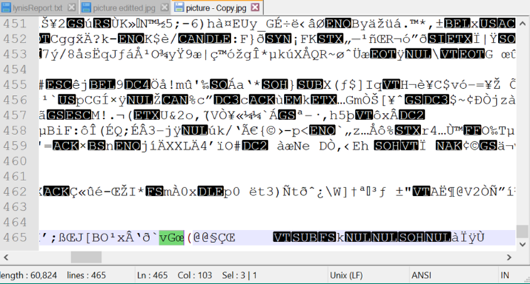
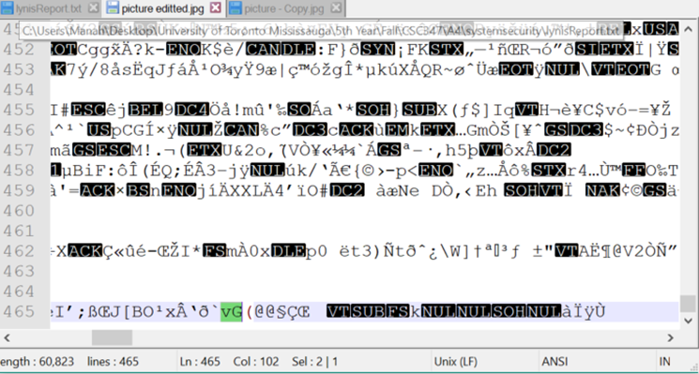
SHA256: c22699c05b52347fdf0046163537f3b7b8a55daad04674ad88d97aefe337cffa
SHA256: ee03b0011a0b8b2a404329c8550b9eb90c483e64da34c7acd89ac76a0b7e6eec

Slide 29
Hash Analysis
Used at any state of the digital forensics process to:
Verify clone is exact replica of original device or evidence.
Verify proper piece of evidence has been handed off.
Integrity check throughout process.
Hash Values:
Hash of original
Hash of copy
Even smallest changes in content make differences in hash value.
Included in documentation and vital for getting evidence presented and used in court.

Slide 30
The Digital Forensics Process
Crime Scene & First Response, Search and Seizure
Acquisition & Imaging, Live vs Dead Imaging, Hash Analysis
Timestamps, File Metadata, Windows Registry
Chain of Custody, Final Reports & Expert Witness
Identification
Evidence Collection & Preservation
Analysis
Documentation & Reporting

Slide 31
Analysis
Identifying and examining vital evidence from acquired data and drawing conclusions to be presented in court.
Somethings to look at:
Time Stamps
MAC
Digital footprint
To put user behind keyboard linking other activity to timeframe
To pinpoint attacker by location and time of attack.
File Metadata
Windows Artifacts

Slide 32
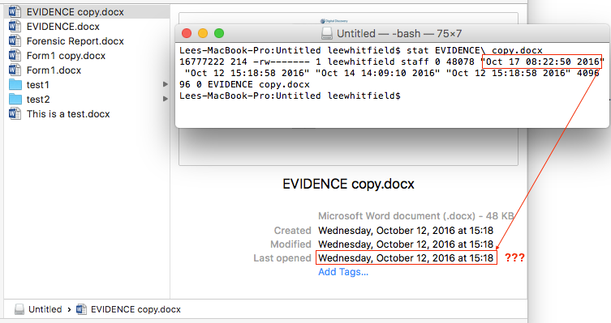
Time Stamps
Using MAC Times:
Modified
Accessed
Created
Other Time Stamps:
Email
Browser History
Link Files
Registry

Slide 33
The Digital Forensics Process
Crime Scene, First Response, Search and Seizure
Acquisition & Imaging, Live vs Dead Imaging, Hash Analysis
Timestamps, File Metadata, Windows Registry
Chain of Custody, Final Reports & Expert Witness
Identification
Evidence Collection & Preservation
Analysis
Documentation & Reporting

Slide 34
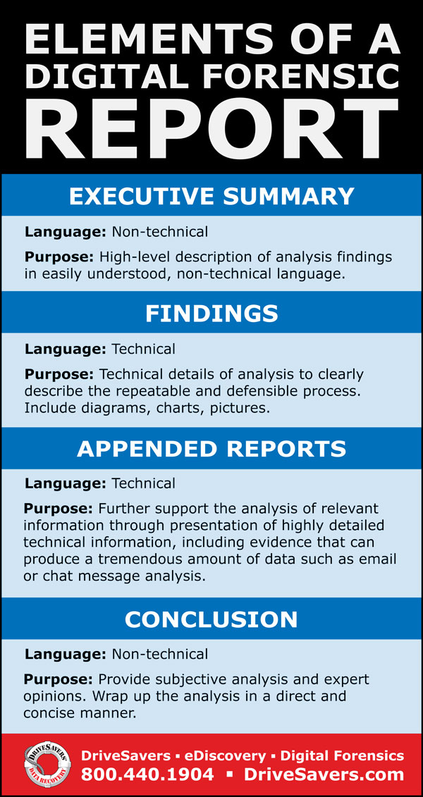
Documentation & Report
Stats and findings with interpretations
Includes:
Chain of Custody
What was done to evidence, why, and by who
Verification Hashes
EVERYTHING DONE TO EVIDENCE SHOULD BE DOCUMENTED!

Slide 35
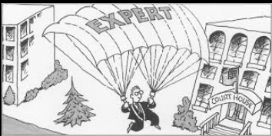
Expert Witness
Digital Forensic Scientist might be called in court as Expert Witnesses.
To explain the process to the judge and jury in layman terms and give opinion
To examine that the steps taken were valid and no mistakes were made by the forensics team in the case
Must have no bias in the case

Slide 36
Bitcoin Crime Process
Analysis
Watched wallet spread out btc in other wallets
Went through emails and confirmed users
Identification Unknown/Online
Evidence Collection and preservation Preservation is insured due to nature of blockchain
Search and Seizure Subpoenaed ISP
Documentation and Reporting
Ongoing + Trial
Acquisition

Slide 37
Anti-Forensic Techniques
Techniques used to hinder digital forensic investigations. Ie. compromise analyst’s reports, delete evidence, obstruct log records of attacker’ activities.
ENCRYPTION
ONION ROUTING
PROGRAM PACKERS
STEGANOGRAPHY
Compress/hide executable files from detection
Hidden digital content within non-secret digital content
DATA DESTRUCTION
CHANGING TIMESTAMPS
Drive Wiping
Change timestamps to escape investigation, hiding attacker’s location and time of attack.

Slide 38
Steganography
The practice of hiding secret data/content in a different type of digital content files that are not secret in order to avoid being detected. ex. text, image, video, audio.
The secret data can be extracted from authenticated people with steganography tools to decode hidden messages.
Often used together with encryption for extra layer.
Malicious Payloads to bypass security and obscure trails.
Hard for forensic experts to know when they are looking at one.
Steganalysis
You’ve probably used Steganography! (Even if you didn’t do the training or last weeks lab…)
Notes:
Youve probably used it, I mean we for sure have in this course but remember the invisible ink pens we used as kids

Slide 39
STEGANOGRAPHY DEMO
Notes:
Show picture
Background about why we named it stonehenge of idiots
What info we can get from image
stegseek stonehengeofidiots

Slide 40
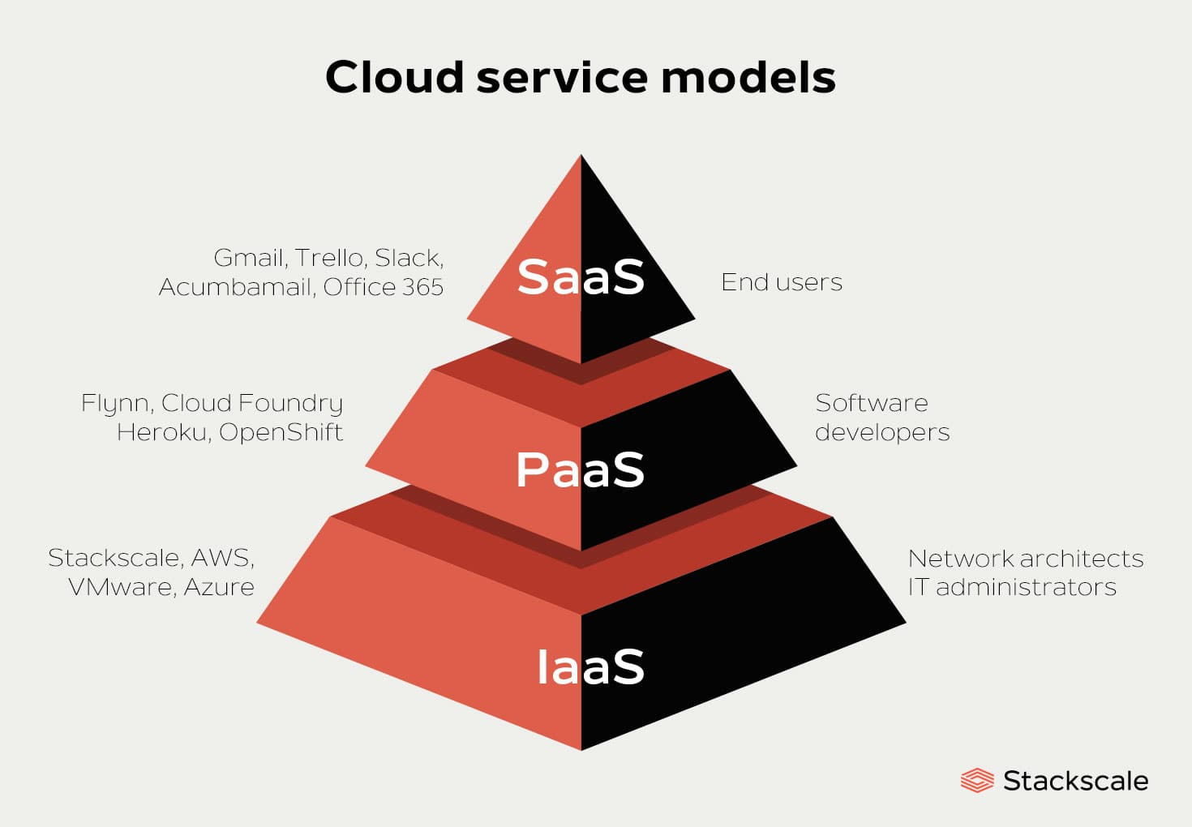
Future of Forensics
Cloud forensics
limited amount of backups
hides the data location from user
CSPs may not report the incident or cooperate
CSPs don’t hire certified forensics investigators
Since all the data is with one CSP, if they have a failure all data is lost
Notes:
Google docs -SaaS
Heroku -PaaS
AWS- IaaS

Slide 41
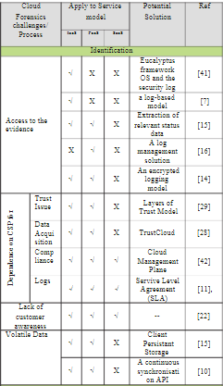
Future of Forensics
Cloud forensics
Different service models have different issues
Ownership of multiple devices makes tracking difficult
Can’t seize CSP’s hard drives
Service Level Agreements (SLA) as a solution
SSD and NAND storage
SSD’s delete old data before overwriting
Notes:
Google docs -SaaS
Heroku -PaaS
AWS- IaaS

Slide 42
Summary
We talked about a lot today! Here are some of the most important parts:
Digital Forensics is the investigative techniques and process for digital evidence.
Digital Evidence != Just PC/Laptop Evidence
Computer Facilitated (= computer as a tool) vs Computer Based (= computer as a target)
4 ACPO Principles among the most followed best practice for electronic evidence handling
The digital forensic process includes Identification of evidence on the crime scene, search & seizure, Evidence Collection via Acquisition & Preservation & uses live/dead system imaging & hash analysis’, Analysis of acquired data, Documentation & Reporting.
Steganography is well known anti-forensic tool used to hide digital content in other forms of digital content.

Slide 43
THANK YOU
Questions?

Slide 44
REFERENCES
Sammons, J. (2015). The basics of DIgital Forensics: The primer for getting started in Digital Forensics. Syngress.
https://www.eccouncil.org/what-is-digital-forensics/
https://onlinedegrees.unr.edu/blog/digital-forensics/
https://ijcsit.com/docs/Volume%208/vol8issue3/ijcsit2017080331.pdf
https://study.com/academy/lesson/first-responders-in-network-forensics-role-purpose.html#:~:text=A%20first%20responder%20in%20a,company%2Dissued%20desktop%20or%20laptop.
https://www.geeksforgeeks.org/digital-evidence-preservation-digital-forensics/
https://www.justice.gc.ca/eng/csj-sjc/rfc-dlc/ccrf-ccdl/check/art8.html
https://thesai.org/Downloads/Volume11No11/Paper_41-Analysis_of_Steganographic_on_Digital_Evidence.pdf
https://cisomag.eccouncil.org/6-anti-forensic-techniques-that-every-digital-forensic-investigator-dreads/
https://www.garykessler.net/library/fsc_stego.html
https://citeseerx.ist.psu.edu/viewdoc/download?doi=10.1.1.641.9370&rep=rep1&type=pdf
https://www.digital-detective.net/digital-forensics-documents/ACPO_Good_Practice_Guide_for_Digital_Evidence_v5.pdf
https://www.youtube.com/watch?v=ZUqzcQc_syE
https://www.wsj.com/articles/bitcoin-bitfinex-hack-crypto-laundering-morgan-lichtenstein-11644953617
https://www.digitalforensics.com/blog/an-overview-of-web-browser-forensics/
https://www.crimemuseum.org/crime-library/serial-killers/the-craigslist-killer/
https://www.forensicscolleges.com/blog/forensics-casefile-craigslist-killer
https://www.goodhousekeeping.com/life/entertainment/a28859869/btk-killer-dennis-rader/
https://www.oxygen.com/sites/oxygen/files/styles/blog-post-embedded--computer/public/floppy-disk-btk-killer.png?itok=N7OMjh3o
https://www.wsj.com/articles/bitcoin-bitfinex-hack-crypto-laundering-morgan-lichtenstein-11644953617
https://www.digitalforensics.com/blog/an-overview-of-web-browser-forensics/
https://www.coindesk.com/policy/2022/02/14/federal-judge-releases-razzlekhan-orders-other-bitfinex-hack-laundering-suspect-to-remain-in-jail/
https://archive.fo/tFc9D#selection-1143.165-1143.258

